Slide 1
The lesbian-feminist project of the 1980s
Rosemary Auchmuty

Slide 2
Origins
Lesbian-feminism was a development of feminism, not of sexuality politics
Previous lesbian organisations: Minorities Research Group 1963 (Arena 3), later Sappho; Kenric 1965
Gateways Club (The Killing of Sister George, 1968)
Gay rights movements: Campaign for Homosexual Equality 1969; Gay Liberation Front 1970: ‘The gay movement is not the women’s movement, has no necessary relationship with feminism’, Liz Stanley.
Women’s Liberation Movement: first 4 demands (socialist feminist) 1970, then radical feminist 1974-7: lesbian feminists have more in common with heterosexual feminists than with gay women.

Slide 3
Theory
Lesbian feminism developed the radical feminist analysis of sex classes, men and women in relationship of oppression in the public sphere and the private: the problem of men
Lesbian feminism replaced the socialist feminist understanding of marriage as a site of women’s primary oppression by an analysis of heterosexuality: women put their energies into male partners and thus sustained patriarchy
Lesbian feminism held that women should put their energies into other women
Separatists and revolutionary feminists went further: women should avoid having men in their lives at all.

Slide 4
Key texts
Adrienne Rich, Compulsory heterosexuality and lesbian existence (1980 in UK): all women exist along a lesbian continuum
Leeds Revolutionary Feminist Group, Love Your Enemy (1979): women should choose to be lesbians to overthrow patriarchy
Lillian Faderman, Surpassing the Love of Men (1981): pioneering history of women-loving women

Slide 5
Reception from existing lesbians and gays
Controversy over whether sexuality can be chosen: many longstanding lesbians did not recognize us as real lesbians, and gay men almost to a man saw sexuality as innate (eg in Clause 28 debates, 1988)
Many longstanding lesbians, largely hidden and ‘outlaw’, feared and resented our determination to be open and political eg Joan Nestle on Adrienne Rich: ‘her call for a lesbian continuum, her wish to expand the theoretical and political world of straight feminist discourse, was to me another exile from the specific lesbian life and communities I had known’.
Some saw us as giving up desire, excitement, the fun of sexuality – because devoted to politics. Not so: we had all these and humour, intellectual challenge, new friends, community – an entire culture.

Slide 6
Reception from heterosexual feminists
Some awkwardness (‘I can’t give up men’, ‘I can still fight patriarchy although married’)
But many chose to become lesbians
Our success was partly responsible for the repressive Section 28 Local Government Act 1988.

Slide 7
Some of the projects
Education: adult education classes (from 1982), then into higher education (eg Graduate Diploma in Women’s Studies at PCL). Lesbian feminist conferences. Lesbians in Libraries.
Law: Lesbian custody, Women Against Violence Against Women, Lesbian Policing Project, campaigns for rape crisis centres and women’s refuges, campaigns against pornography and prostitution
Writing: Jan Bradshaw and Mary Hemming eds. Girls Next Door: Lesbian Feminist stories (The Women’s Press 1985); Valerie Mason-John and Ann Khambatta, Lesbians Talk Making Black Waves (Scarlet Press 1993)
Publishing (Onlywomen Press 1975; Gossip: a journal of lesbian feminist ethics, 1986)
TV (Gay Alive, Out, Women Like Us)

Slide 8
Lesbian history: reclaiming from invisibility
Lesbian History Group founded 1984 after Lesbian Studies Conference
Met fortnightly at women’s centre in Holborn; we had speakers including Jane Rule, Lillian Faderman, Martha Vicinus, Janice Raymond, Emma Donoghue, Suzanne Neild and Rosalind Pearson (editors of Women Like Us); Naiad Press, Hall Carpenter Archives etc
and member-led discussions
We published Not a Passing Phase: Reclaiming lesbians in history 1840-1985 (The Women’s Press 1989)

Slide 9
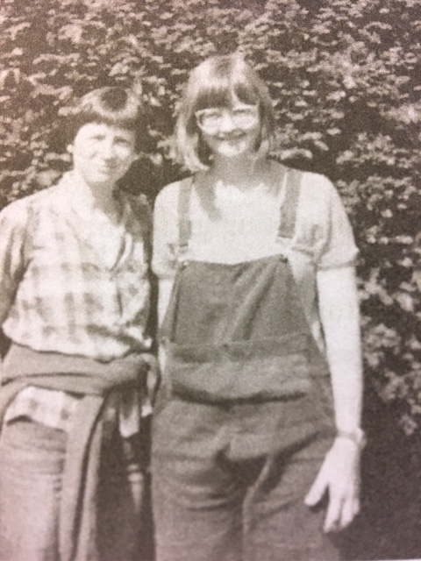

Slide 10
Rationale for lesbian history
Developed from women’s history, itself shifting from adding women into historical accounts to analysing their relationship to men (Feminist History Group, The Sexual Dynamics of History, Pluto 1983)
We need the history of all people, social structures and attitudes
and a heritage of our own: ‘Lesbians have been deprived of virtually all knowledge of our past. This is deliberate since it keeps us invisible, isolated and powerless’, 2).
Understanding the past provides tools for future liberation.

Slide 11
Methodological problems
Usual problems of sources for women’s history: most women don’t leave records
History has traditionally been about men and public events; the private sphere is deemed unimportant and discarded.
Even where sources are available, they may be seen as irrelevant
Or suppressed as embarrassing: associations with perversion
And the life ‘normalized’: deny the close relationships with women, upgrade the passing acquaintances with men.

Slide 12
Evidence and proof
‘Some of us might feel very positively about our own lesbian identity but we still fall over ourselves not to libel the dead … Our anxiety arises partly from a … belief … that the term “lesbian” refers solely to a sexual practice, and not to a mode of life in which a woman’s political, intellectual, social and sexual energies are focused on other women’ (Not A Passing Phase Intro)
‘Does it matter if they did it?’ (Sheila Jeffreys): we don’t expect proof of sexual activity for heterosexuals.
Hypothesis: she lived with a woman, moved in women-only circles, knew other women-identified women

Slide 13
Lesbian history: not the same as gay
Rosemary Auchmuty, Sheila Jeffreys and Elaine Miller, ‘Lesbian History and Gay Studies: Keeping a feminist perspective’ (1992) 1 Women’s History Review 89-108
Just as feminists had to argue for ‘woman’ not to be subsumed into ‘man’, so lesbians must fight for ‘lesbian’ not to be subsumed in ‘gay’ or ’homosexual’ – ‘lesbianandgay’ studies (later LGBT)
These terms almost always mean men, or men with a reference to lesbians tacked on, or presented as if an identity of interests, or ‘a pale version of the male’

Slide 14
Gay men as norm make us invisible
Gay men often know nothing about women; many actively dislike them, and most are indifferent to women’s issues
Our priorities were/are different: men wanted to legalise cottaging; women wanted custody of their children (cf today, differences over surrogacy)
We quoted Liz Stanley on what happened when women in CHE asked the men to give up having sex with strangers in public lavatories: ‘Come the revolution, sisters, they suggested, you too will be liberated enough to do this’ (99).

Slide 15
Grouping, subsuming and silencing continues
In later 1980s, lesbian energy was diverted into gay causes, and lesbian experience was submerged beneath men’s - in AIDS crisis, section 28 campaigns
Today we have LGBTIQ+, which not only means that our separate experiences of sexuality are overlooked, but sexuality itself is subsumed into/replaced by gender identity.

Slide 16
In scholarship, replaced by queer
Queer is an umbrella term encompassing all non-normative sexualities and gender identities. Lesbian feminism is concerned with women and women’s embodied experience.
Lesbian feminist theory, like queer theory, sees gender and sexuality as socially constructed, but (unlike queer) not sex itself.
So once again, the specific lesbian experience is disappeared, and crucially, the politics: its location in a feminist analysis of male power.

Slide 17
Radical politics replaced by rights
Today we talk of equality, diversity and rights: ‘lesbian’ is defined in terms of sexual orientation and personal choice.
Still little questioning of the naturalness of heterosexuality; instead, lesbianism (and trans) have been incorporated into naturalness, all part of humanity’s diversity.
Lesbian experience has been mainstreamed: it is seen as, and increasingly looks, just like heterosexual (eg same-sex marriage)
Thus, once again, removing the politics.

Slide 18
Why we still need lesbian feminism
Lesbians are women, and women worldwide remain excluded, exploited, and oppressed – because women’s empowerment threatens male power and control of women.
Of all women, lesbians are the most empowered (as not reliant on men for sex and companionship) and thus the most threatening to patriarchy.
Adrienne Rich: ‘Lesbian existence comprises both the breaking of a taboo and the rejection of a compulsory way of life. It is also a direct or indirect attack on male right of access to women’ (52).

