Slide 1
Lesbians, loneliness, and love:
challenging robotic pornographic culture
Kathleen Richardson

Slide 2
Rainbows everywhere but where are all the lesbians?
For people aged 16 and over, more than 1.5% - 748,000 - identify as gay or lesbian, and 624,000 (1.3%) as bisexual.
On average, globally, 80% identify as heterosexual, 3% as gay, lesbian or homosexual, 4% as bisexual, 1% as pansexual or omnisexual, 1% as asexual, 1% as “other”, and 11% don’t know or won’t say.

Slide 3
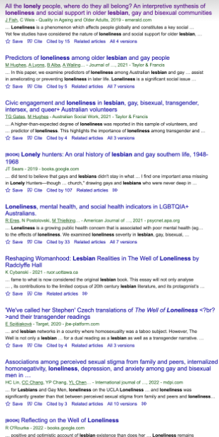
invisible
two lesbians at work (that I know of), plenty of ‘queer’ ‘trans’ and pronouns in bios promoted.
EDI monitoring used term ‘gender-attracted’ -and lesbian erasure means I have to become a political lesbian.

Slide 4
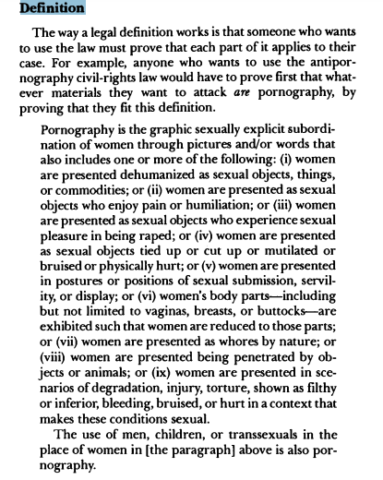
Pornography
Pornography and Civil Rights
Dworkin and Mackinnon 1988

Slide 5
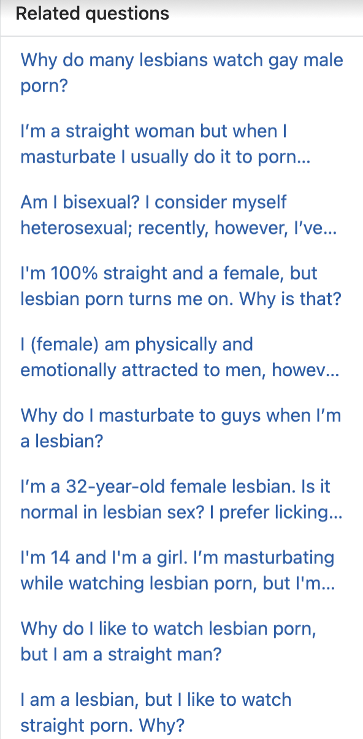
pornography and identity
viewing of heterosexual pornography - men penetrating women, identification with male in imagery, arousal by dominance and submission, uncertainty about roles in relationships, absence of part (penis)
Lesbian porn developed for male market.

Slide 6
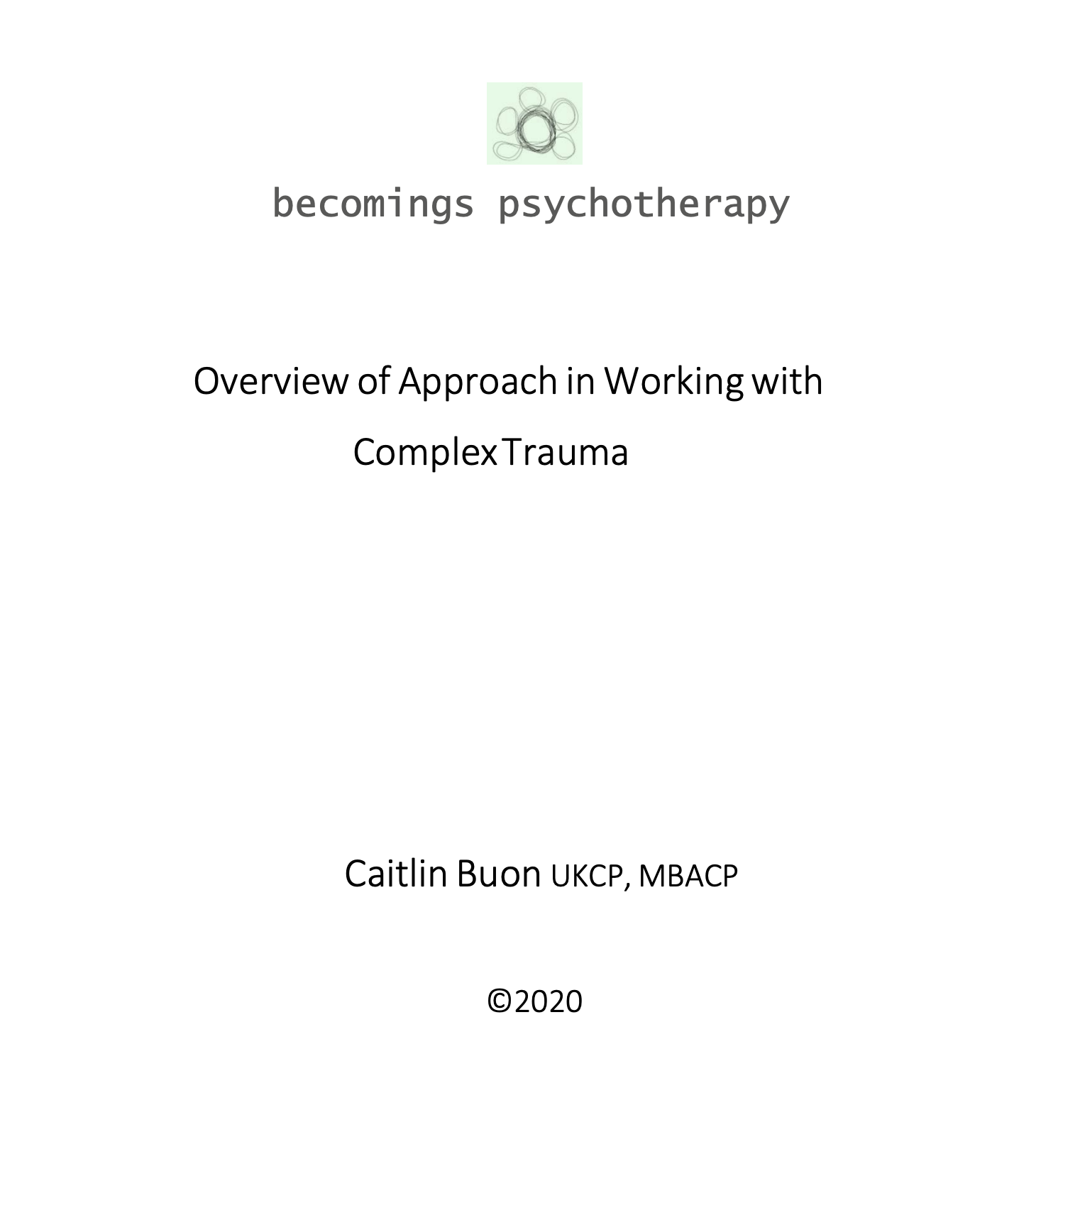
approach
Combine theories which prioritise relationships between humans.
Radical feminism
Dialogical Phenomenology
Trauma-informed therapeutic approaches
Psychodrama/sociodrama
Anthropology
Childhood studies

Slide 7
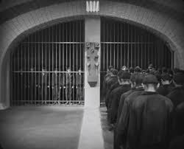
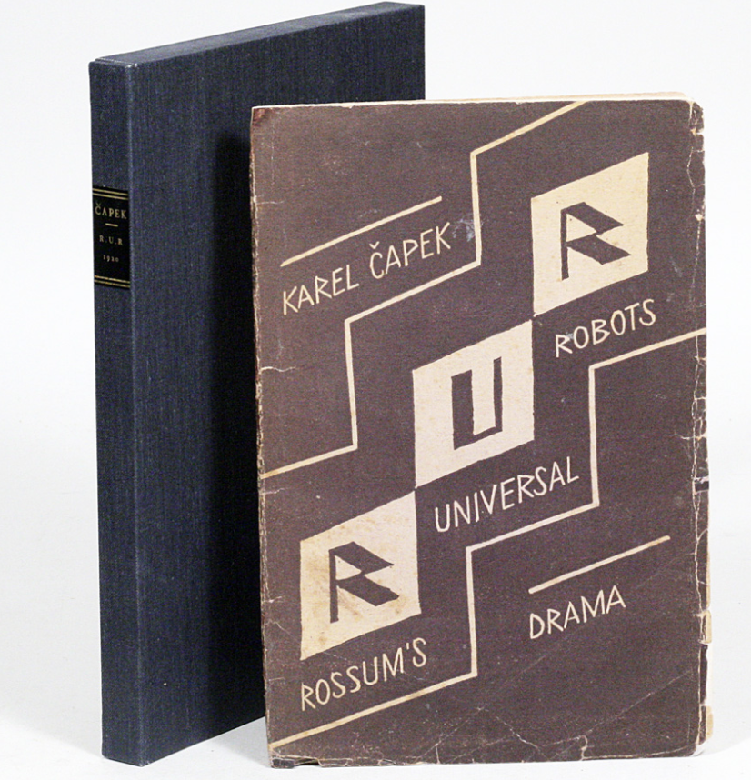
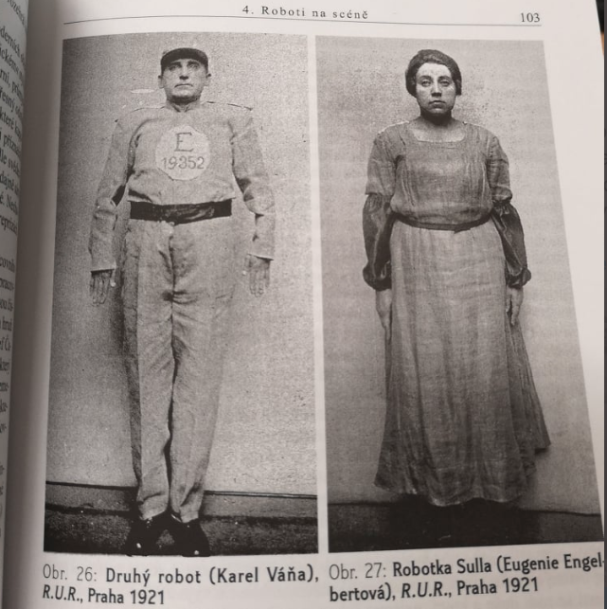
robots

Slide 8
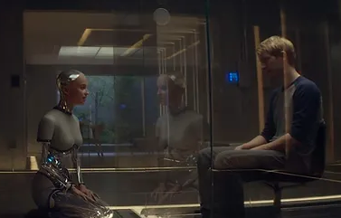
Representational Technologies of the Human *(women and girls)

Slide 9
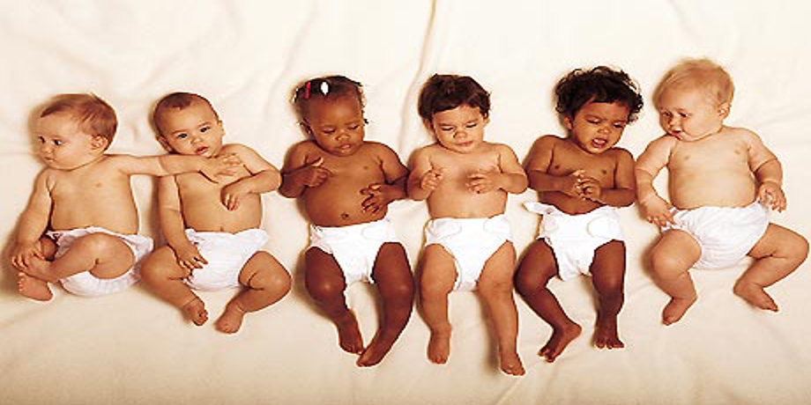
attachment
Infants are born helpless and need to be cared for
Stable, enduring, safe and secure relationships best for child development.
Through attachment (the closest form of relationship), a relational template emerges that is used by the person throughout their lives to make other close forms of relationship (pair-bonded, friendships), but also usefulness in making other kinds of relationships (colleagues, associates), and interactions (strangers, anonymous others)
Childhood trauma in families through abuse leads to dysregulation, emotional, cognitive, bodily difficulties.
Strategy of survival: dissociation (pretend what is happening isn’t happening).
Trauma responses: flight, fight, freeze, fawn, flop.

Slide 10
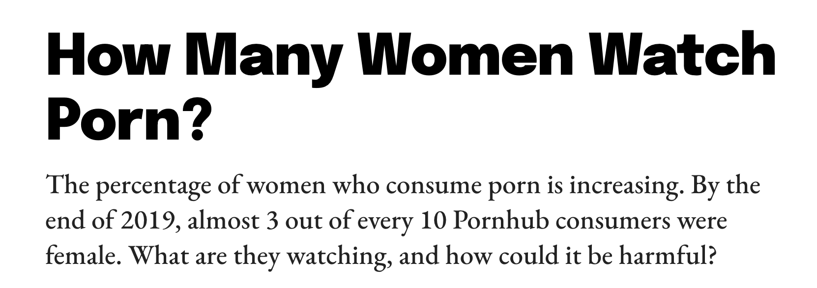
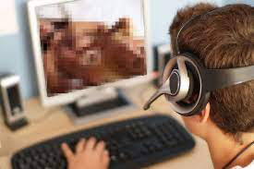
interpersonal relationships
Relationships based on give-and-take
Responsiveness to the other
Differentiation of self from other (separate but connected)
Empathy (ability to recognise the thoughts, feelings of others and respond appropriately)
Emotional regulation - ability to regulate one’s emotions
Bodily regulation - regulation through interpersonal interaction

Slide 11
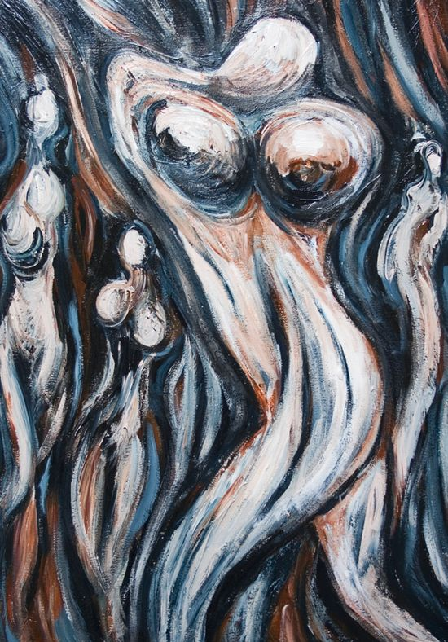
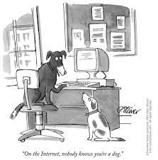
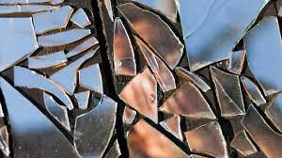
robots/Politics of Dissociation
Depersonalization/ Derealization Disorder
Depersonalization – experiences of unreality or detachment from one’s mind, self or body. People may feel as if they are outside their bodies and watching events happening to them.
Derealization – experiences of unreality or detachment from one’s surroundings. People may feel as if things and people in the world around them are not real.

Slide 12
porn’s impact on self, identity and relationships
Externally generated
Mediated through screens
Pain/suffering detached
Lack of interpersonal regulation and inventiveness

Slide 13
“Surplus of fiction”
In representational technologies of the human:
Example “imagine a world in which robots are just like us (almost)…in which the boundary between our perceptions of robots and our perceptions of fellow humans has become so blurred that most of us treat robots as though they are mental, social, and moral beings” (2007:303)—he predicts 2050 as the year this will happen!
In pornography
No woman is harmed, it’s free speech and expression, it’s sex

Slide 14
an attachment/trauma point of view
Pornography viewing interferes with sexual, emotional and physical responsiveness

Slide 15
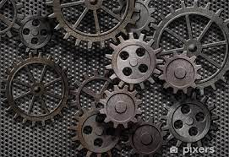
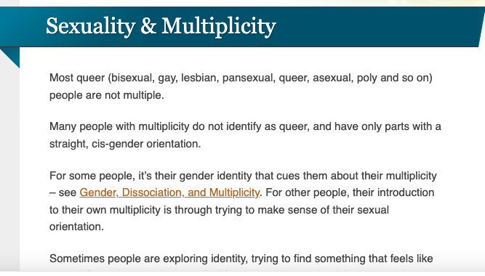
But dissociation is not being healed through relationship but generated through tech+porn+gender ideology

Slide 16
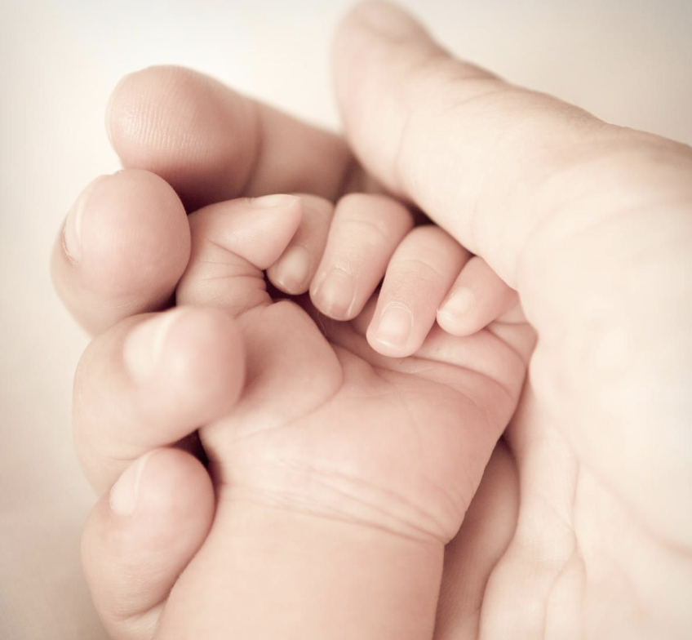
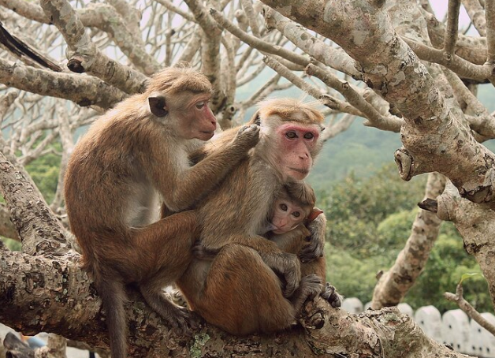
the Politics of Love
Living beings are not images on surfaces, we are not elaborated symbols. We are not representations of something, but are something. Living beings exist in aliveness and in connection. Connection is the threat. The diversion away from people to surfaces is the driving force.

Slide 17
future work
Odradekgroup
Gay, lesbian and bisexual group - a theory group
and an association.
With Gary Powell.
Develop ethical guidelines
Pornography
Robots
Prostitution
Gay and lesbian rights
Child rights
Create a working group to revive the Dworkin
And MacKinnon ordinance

Slide 18
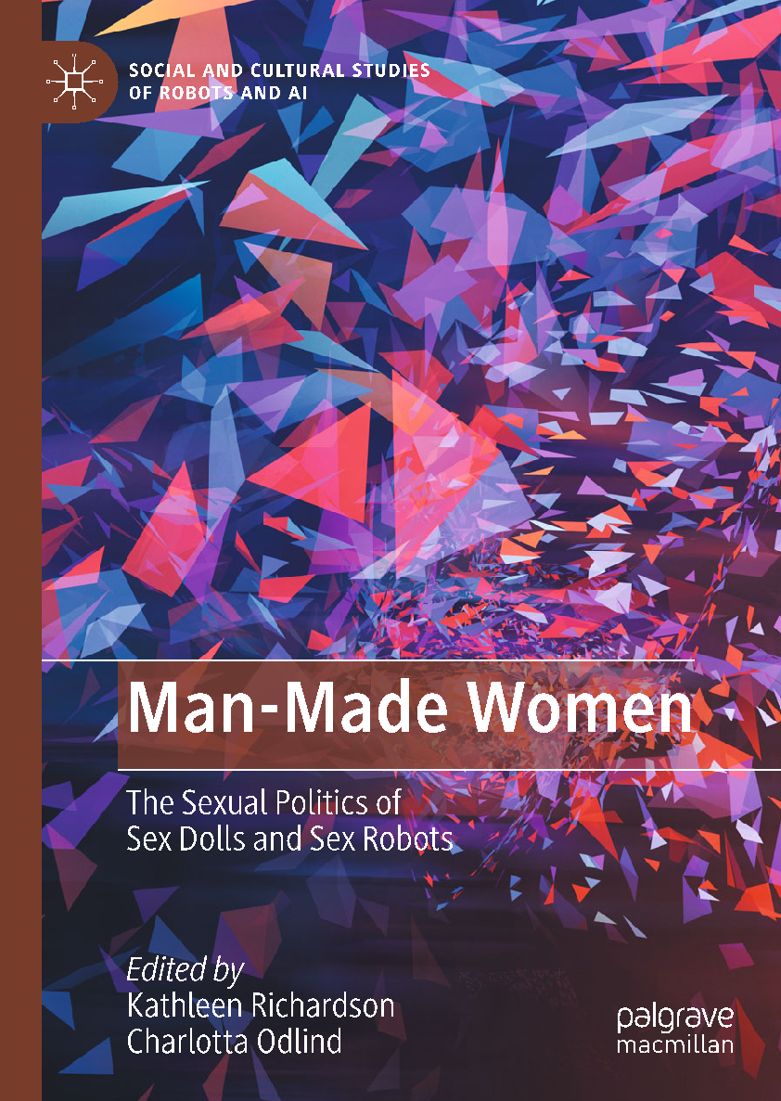
recent publication
Thank You
contact@kathleenrichardson.org

