Slide 1
Lesbians and Justice
Jo Phoenix

Slide 2
Issues to think about
Equal access to the law (lawbreakers)
Equal protection by the law (victims)

Slide 3
Equal access to the law
Are lesbians discriminated against, based on being lesbian, when they are processed in the criminal justice system?
Problems of methodology – What counts as a lesbian? Who is doing the counting? When is the counting done?
Women are doubly deviant, doubly damned and perhaps lesbians are doubly deviant but perhaps triply damned

Slide 4
Evidence?

Slide 6
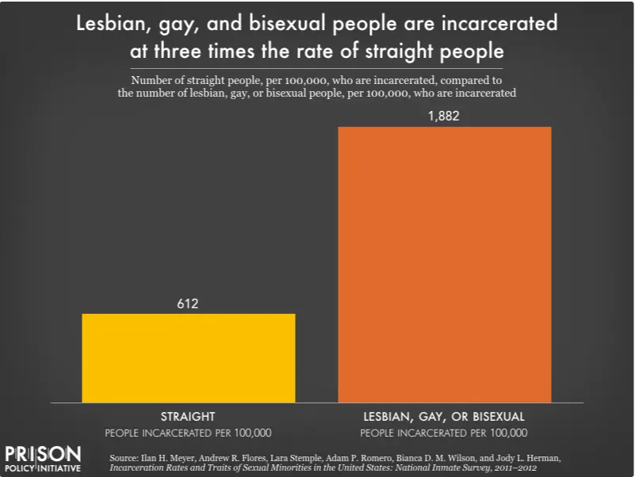

Slide 7
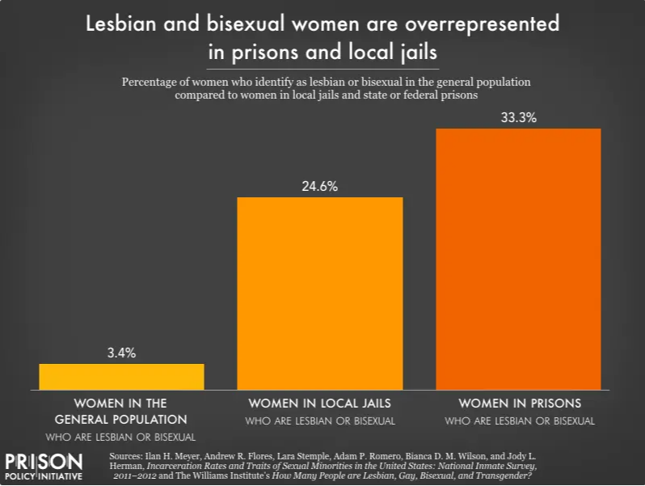

Slide 8
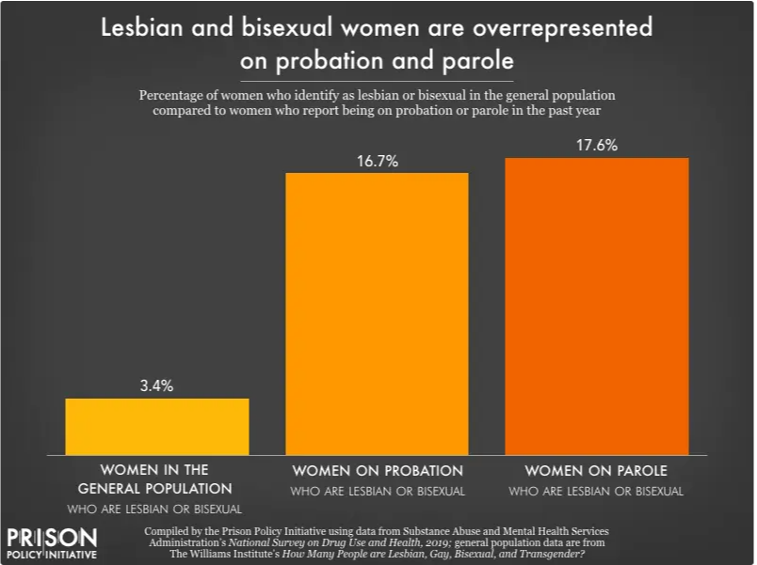
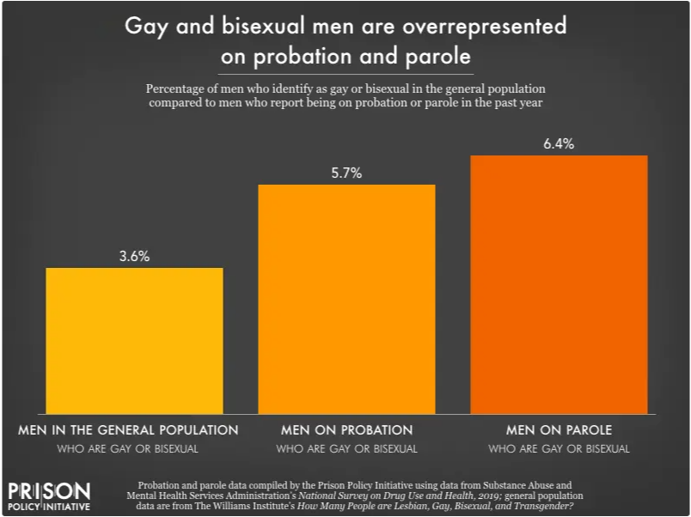

Slide 9
Equal protection by the law
Victimisation
Hate Crime
Studies?

Slide 10
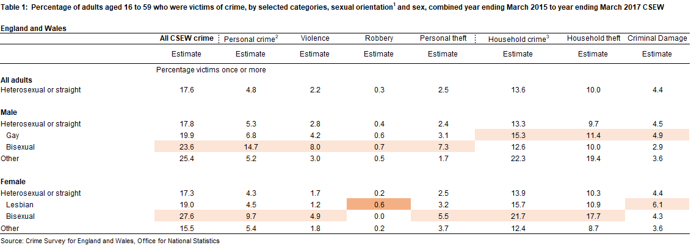

Slide 11
Hate Crime
 | Sexual Orientation | Transgender
2011/12 | 4345 | 313
2012/13 | 4241 | 364
2013/14 | 4588 | 559
2014/15 | 5591 | 607
2015/16 | 7194 | 858
2016/17 | 9157 | 1248
2017/18 | 11592 | 1703
2018/19 | 14,472 | 2329
2019/20 | [x] | [x]
2020/21 | 18,596 | 2799
2021/22 | 26,152 | 4,355
Perceived by victim
Flagged by police
5 strands:
Race
Religion
Sexual orientation
Disability
Transgender

Slide 12
Studies?
British journal of criminology |  | 62 | 0
Theoretical Criminology |  | 23 | 0
Criminology and criminal justice |  | 33 | 0
Howard journal |  | 14 | 0
Punishment & Society |  | 17 | 0
Crime and Delinquency |  | 34 | 0
Crime, Media and Culture |  | 16 | 0
European journal of criminology |  | 12 | 0
Feminist Criminology |  | 57 | 1

Slide 13
So what?
We think lesbians are probably denied equal access to the law and equal protection by the law but cannot prove it.
We do not know what lesbians' experiences are of the criminal justice system.
If we do not know any of this, we have *NO* basis on which to create lesbian appropriate policies, programmes and support services.

Slide 14
Thank you

