Slide 1
Lesbians and the importance of Lesbian space
Dr Sue Regan
Durham University
Putting Lesbians Back in Focus: 25th March 2023

Slide 2
Introduction
Themes: Identity and Community
What does lesbian mean?
What is lesbian community?
Why are lesbian spaces and communities important?
How can we improve knowledge of, and data collection about, lesbians?
Notes:
Hello! And Introduce myself -…
I’m going to outline some ways of thinking about identity, and community. Might be familiar to you, or not – time for questions at the end

Slide 3
Lesbian Identity: What, why, how? And who!

Slide 4
What do we mean by ‘lesbian’?
A woman who is attracted to other women
A woman who is not attracted to men
Any person who identifies as a woman, and is attracted to women
A biological female who is attracted to other biological females
Any woman who identifies as a lesbian
Any person who identifies as a lesbian
Notes:
Ideas, Concepts:
Definitions

Slide 5
Symbols of Lesbianism
Notes:
Why are symbols important?
Logos, flags, gestures
Because they ‘stand for’ an idea, a political view, an identity …
They are shorthand and they transcend language.
They provide a visual representation
They signify ‘community’ and membership
Examples:
The double interlocking women’s symbol
The inverted black triangle – ‘outsider’ status (transgressing ‘ideal of womanhood’)
The Labrys flag

Slide 6
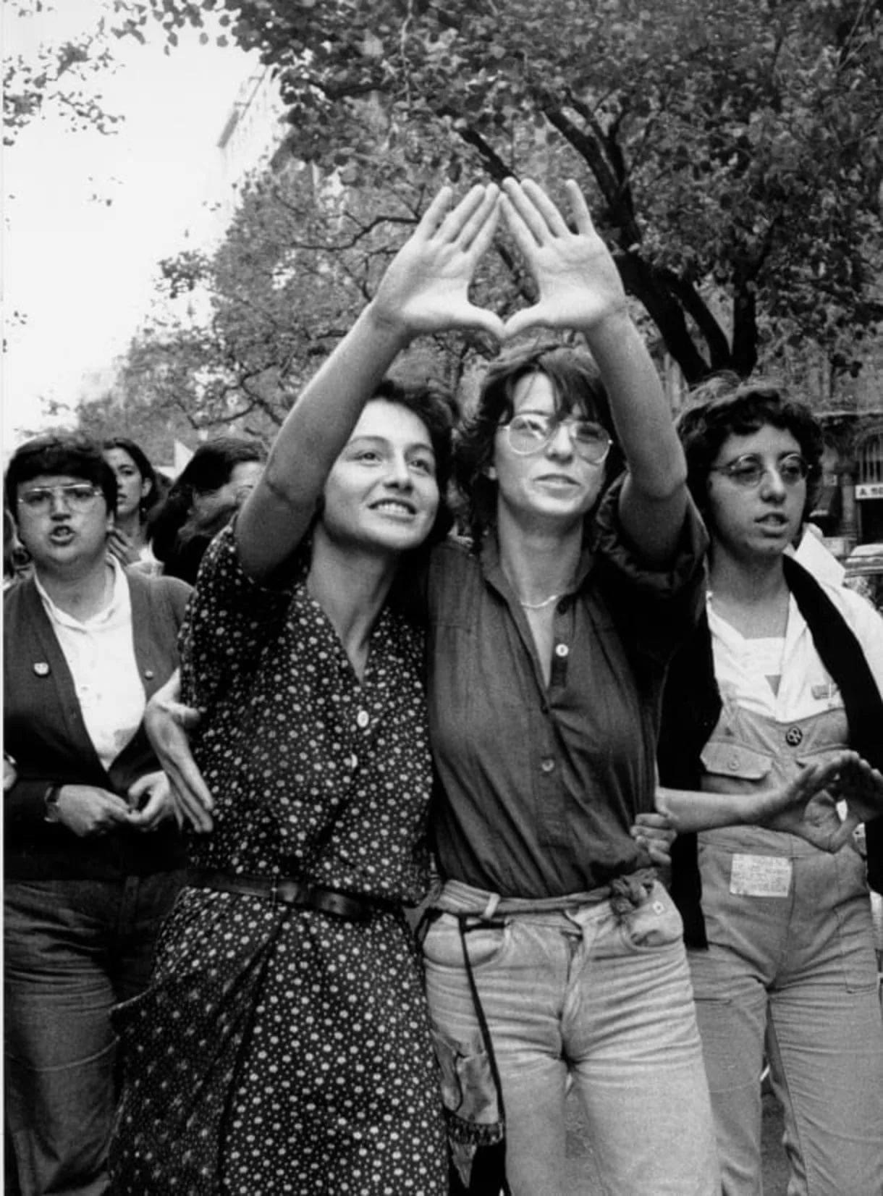
Notes:
Symbols crossing centuries and generations:
This photo is from late 1970s (USA, photographer unknown); same symbolic gesture seen at Lesbian Strength March (Leeds, UK) in 2019.
This visual gesture symbolises the vulva, the female body, lesbianism as a female embodied experience, and an erotic one

Slide 7
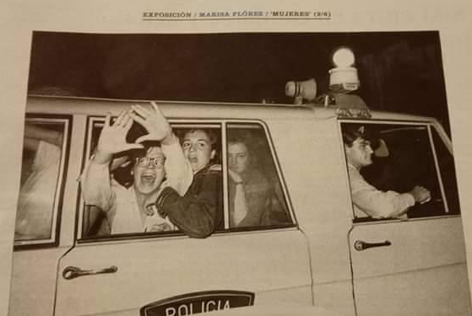
Notes:
Here the vulva symbol is even more rebellious – while being arrested, in a police car, this lesbian makes the symbol as an act of defiance
These women are recognisable to us as lesbians – perhaps we’ve seen these photos before, or other similar ones – of lesbians at Greenham Women’s Peace camp for instance
But how do we know what ‘lesbian’ is?

Slide 8
How we get to lesbian: perspectives 1
Different areas of academic study:
Medical/Psychological
Historical
Cultural
Sociological
Political
Global perspectives
Notes:
Academic concepts. And discourses:
Outline: different terms, underpinning concepts/ discourses, developments, in theorising women sexually attracted to women (lesbians)
Understanding, language, context, time and place
Proposition: How lesbians are conceptualised, and viewed/treated in practice, is inextricably related to, and inseparable from, how women are viewed/treated socially and legally, in patriarchal, male-dominated societies and institutions

Slide 9
Is Lesbian Obsolete?
Is Lesbian being erased?
‘Definitional mortality’:
If Lesbian = “all women, trans and cis, who describe themselves as lesbian, gay, bisexual, pansexual, queer or otherwise non-heterosexual, and trans and/or non-binary, genderqueer, or genderfluid people who describe themselves as lesbian”
Special Issue: ‘Is Lesbian Identity Obsolete?’ Journal of Lesbian Studies (2022, Vol.26:1)
The social pressure (incl. threats, abuse, intimidation) on lesbian events and groups to admit ‘whoever defines as a lesbian’ including those who are male-bodied and male-presenting.
The closure of lesbian-only groups
The change from lesbian-only spaces (groups and events) to spaces for LGBTQIA+ women and non-binary people
Notes:
I propose the term ‘definitional mortality’ to describe this situation where the definition of a word/term with widespread recognition (across time, places, spaces) has been changed to such an extent (and that change has accrued widespread if contested usage) that it has lost that previously accepted meaning and is therefore defunct (dead) in terms of its original purpose.
Is Lesbian Obsolete?
Is Lesbian being erased?
Does the term ‘lesbian’ have a specific or elastic meaning?
Is ‘same-sex attraction’ between women an anachronistic ‘preference’ analogous with ‘sexual racism’? Or as hateful as anti-Semitism?
Stonewall risks all it has fought for in accusing those who disagree with it of hate speech | Sonia Sodha | The Guardian
Stonewall brands lesbians 'sexual racists' for raising concerns about sex with transgender women | Daily Mail Online
The truth will out | Josephine Bartosch | The Critic Magazine
Are individual lesbians being renamed/ reframed?
Are lesbian spaces being targeted to accept ‘anyone who identifies as lesbian’? Are lesbian-specific spaces closing/ going underground?

Slide 10
The Disappearing Lesbian (1)
Anne Lister:
Gender
Non-conforming?
Notes:
Being de-lesbianed! “Did you say something?”
My experience: Interviewed for independent cinema anniversary film, about experiences of going there in 1980s. Invited because I had mentioned being lesbian and going to see lesbian films with other lesbians. Throughout the interview, she used the phrase ”as an LGBT person” to me. Yes, I said the first time “actually I’m not an LGBT person, no-one could be all that. I’m a lesbian. Please refer to me as a lesbian”. But she just kept saying “LGBT person”. At the end, off-camera, I said again “ Please, in the edits, will you make sure I’m referred to as a lesbian? I’m not an LGBT person!”
See also, Julia Diana Ghassan Robertson, referred to as “queer”:
Why didn’t you say something sooner?—You’re Asking The Wrong Question - The Velvet Chronicle
Anne Lister:
Plaque in York honours 'first modern lesbian' Anne Lister - BBC News (24.07.2018, GNC plaque) and
Anne Lister: Reworded York plaque for 'first lesbian' - BBC News (28.02.2019, lesbian plaque)

Slide 11
The Disappearing Lesbian (2)
Stormé DeLarverie:
He/him?
Notes:
History, Herstory: Who writes our stories?
Stormé DeLarverie:
Harper's Magazine Claims They Can Change Stormé DeLarverie to a "He" - The Velvet Chronicle

Slide 12
“Respondents were often aware of, and reflective about, current debates situating the category “lesbian” as problematic or obsolete — particularly in contrast to queer discourses — and nonetheless found utility and meaning in continuing to use the term in their everyday lives, for both personal and political reasons.”
Retain a lesbian sense of self and community
Shared sense of historical and political connection
Importance of visibility, specificity, and sexual boundaries
Megarry et al (2021) ‘Women who prefer “lesbian” to “queer”: generational continuity and discontinuity’
Notes:
However, examples of persistent ‘lesbian’ identity:
Jessica Megarry, Catherine Orian Weiss, Meagan Tyler and Kate Farhall (2021) ‘Women who prefer “lesbian” to “queer”: generational continuity and discontinuity’. Journal of Lesbian Studies, DOI: 10.1080/10894160.2021.1950271
And this article:
Stacy I. Macias (2022) “Somos contra la ‘queer-ificacíon’”/“We reject the queer-ification of lesbianism”: lesbian political identity and anti-queer politics among Mexican lesbians and queer Chicanas-Latinas, Journal of Lesbian Studies, 26:1, pp.73-88, DOI: 10.1080/10894160.2021.1959886

Slide 13
How we get to lesbian: perspectives 2
The lesbian continuum:
“to include a range - through each woman’s life and throughout history – of woman-identified experience”
and
Lesbian existence (is) “an act of resistance”
Adrienne Rich (1981, pp.20-21)
“A lesbian is the rage of all women condensed to the point of explosion”
Radicalesbians (1970, p.1)
Notes:
Lesbian feminist politics from the mid-late 20th C
Feminist theorising – making links between women under patriarchy (subordination, consciousness and agency) and lesbian identity.
Examples:
Adrienne Rich (1981) Compulsory Heterosexuality and Lesbian Existence. London: Onlywomen Press.
“If we consider the possibility that all women … exist on a lesbian continuum, we can see ourselves moving in and out of this continuum, whether we identify ourselves as lesbian or not.” (pp.22-23)
Radicalesbians (1970) The Woman Identified Woman. Pittsburgh, USA: KNOW Inc.

Slide 14
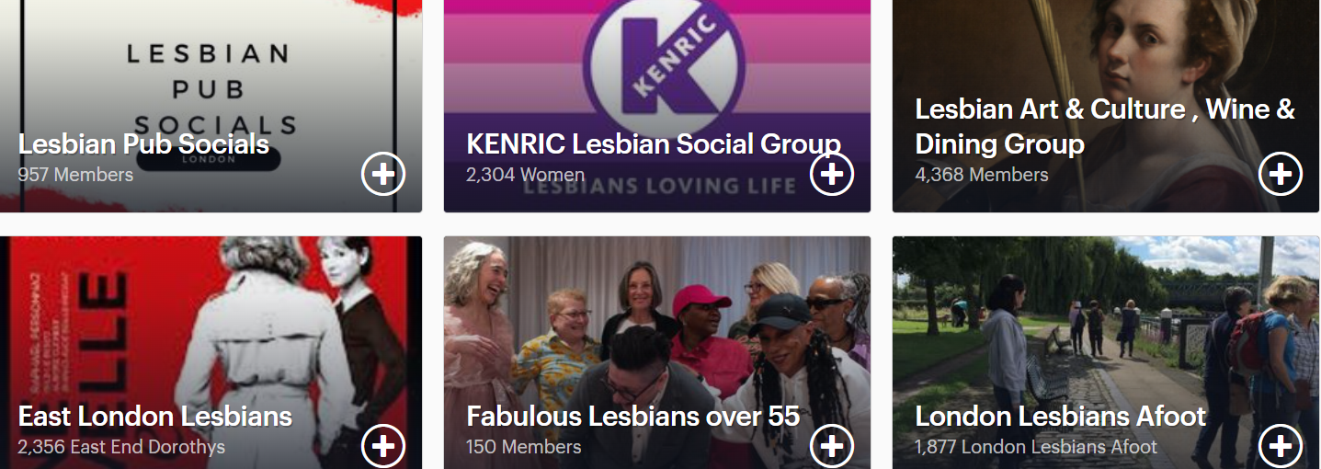
How we get to lesbian: perspectives 3
Notes:
Snapshot of some Lesbian groups in London - Meetup
Using ‘lesbian’ as a signpost term – a recognisable descriptor for women attracted to women – some groups are Lesbian, others are LandB, LBQ or LGBT+.
Other characteristics/ intersections are highlighted e.g. Black/Women of Colour, age categories, etc.
Within and beyond UK
What are the global / linguistic variations, attitudes, experiences?
Context -specific refusals, acceptances, developments
Gendered stereotypes – expectations, limitations.
Lesbians/ status of same sex attracted women inseparable from the status of women generally – constraints/ choices beyond heterosexual marriage, children and domestic life? Access to education? bodily autonomy? economic independence? legal or political power?

Slide 15
How we get to lesbian: perspectives 4
Zimbabwe: “I’m attracted to girls, and I’m not attracted to men. I guess that’s what makes me a lesbian. Emotionally, physically, everything, I’m attracted to girls… that’s what makes me lesbian.”
(Muparamoto, 2022, p.274)
Burundi: “There are ‘invisible’ lesbians in every country. We are just one part of it.”
“If we exist here, we exist everywhere.”
(Mohan 2019)
Notes:
Further examples of persistence of ‘lesbian identity’
Zimbabwe: Nelson Muparamoto (2022) “Lezibian/mulezi”: adoption of “globalized” lesbian identity and secondary self-labels among same-sex attracted women in Harare. Journal of Lesbian Studies, 26:3, 269-285. DOI: 10.1080/10894160.2021.2006868
Burundi: Megha Mohan, (2019) The secret language of lesbian love: the wives, mothers and friends who hide their sexuality. February. BBC. Available at: https://www.bbc.co.uk/news/resources/idt-sh/secret_lesbian_language Accessed: 23.03.2023.

Slide 16
Japan Iran
Lesbian couple Ayaka and Akane hold symbolic wedding ceremony (2015)
Kiana Firouz, a lesbian film-maker seeks asylum in UK (2010)
Notes:
And some more examples, in the face of state opposition:
Claiming legal recognition/ rights which may be available in the UK but not in other places.
Japan: https://www.asiaone.com/women/japan-lesbian-couple-wed-amid-calls-same-sex-marriage
APRIL 19, 2015. TOKYO - A lesbian couple held a symbolic wedding ceremony in Tokyo on Sunday, as calls grow for Japan to legalise same-sex marriage. their marriage will not be recognised under law, actresses Ayaka Ichinose, 34, and Akane Sugimori, 28.
Iran: https://www.theguardian.com/commentisfree/2010/may/22/gay-asylum-seeker-refugee
Kiana Firouz is an Iranian activist and filmmaker currently residing in the UK. In Iran, she worked underground as an activist for Iranian homosexual women's rights, shooting footage for a documentary about human rights abuses. Her activities having been discovered by Iranian security services, Firouz was forced to relocate to the UK.

Slide 17
Lesbian as ‘same sex’
“I say ‘dyke’, I say ‘lesbian’, I use the word ‘zami’, though it’s not the first word I’d use about myself. When I’m with Turkish women, I use a Turkish word, which is sevici, the technical word for a lesbian or gay. It translates as ‘same sex’. That’s the word that most people know, common terminology for me.”
Interview with Havva, in Ainley (1995 p.69)
Notes:
Ainley, R. (1995) What is She Like? Lesbian Identities from the 1950s to the 1990s. London and New York: Cassell.

Slide 18
The only constant truth about The Lesbian … has been that she prefers women
(Faderman 1991, p.308, my emphasis)
Notes:
‘Preference’ – contested term, indicates choice, and freedom to choose, which is not the experience of many lesbian women
But here ‘prefers women’ is used to refute hegemonic (compulsory, universal) heterosexuality.
Lillian Faderman (1991) Odd Girls and Twilight Lovers: a History of Lesbian Life in 20th Century America. New York: Columbia University Press.

Slide 19
So far, lesbian can be understood as
Identity: labels vary across time and place
Attraction/ desire: focus, persistent, congruent
Behaviour: innate, consistent, active, genital
But also, identity loves company
Community: sex-separate, autonomy, inclusivity, difference, boundaries
Notes:
Identity (labels) vary
Labelling because we are a minority, and we experience discriminatory attitudes and behaviours. How can I know if she is ‘like me’?
Labels can denote a shared similarity, not sameness? Some women embrace, others reject the lesbian label; some choose other labels; some want no label.
Same-Sex Attraction (Desire/ Behaviour)
is universal, in that it exists across time and place
Importance of community
We seek others ‘like us’

Slide 20
Why Lesbian Community?
Belonging
Autonomy
Support
Protective environment
Intersections
Boundaries
Notes:
Ideas, Concepts about Lesbian Spaces:
Importance of ‘Association’

Slide 21
What is lesbian community?
Lesbian relationships: partners (girlfriends, lovers, exes)
Lesbian friendships (online, in-person)
Lesbian groups and organisations
Lesbian events, campaigns
Lesbian places
Lesbian culture – music, books, films, representation, role models, etc.

Slide 22
Where are lesbian spaces?
Lesbian specific
e.g. autonomous same-sex attracted lesbian groups
Lesbian within a broader women’s or feminist space
e.g. the Lesbian Archive is housed with Glasgow Women’s Library; lesbian sessions at FiLiA conferences
Lesbian within a broader LGBT+ space
e.g. lesbians within DIVA, LGBT Federation, ILGA
Notes:
Lesbian autonomy is not only about lesbian-only space – it also includes specific lesbian spaces:
So Black lesbians or Lesbian Women of Colour; lesbian mothers; lesbians with disabilities e.g. (neurodivergent, or deaf/ hard of hearing); older or young lesbians
The lesbian space within a broader organisation or place may be designated as separate – a separate lesbian night at an otherwise mixed LGBT+ club;
or it may be that lesbians are included in the broader group or event, either implicitly (L = lesbian) or explicitly (lesbians welcome)
Lesbians as part of mixed organisations (lesbian and gay – women and men) have a fraught history – e.g. Friend Helplines, ILGA
Lesbians at London Friend
The history of ILGA (1978- 2012) | ILGA World

Slide 23
The loss of lesbian spaces (bars)
“Virtual and physical spaces are wholly different when it comes to interpersonal engagement. Bodies matter - the presence of bodies affects our emotional registers of empathy, compassion, and intimacy.
“Assimilation” is a double-edged sword of cruel optimism: We want to be treated the same and given the same opportunities as others, but we bitterly fear the erasure of differences -cultural differences that establish our communities - in the quest for equality.
“The promise of acceptance has transmogrified into a resentment of assimilation, and, for lesbians specifically, a lamentation about the nationwide plague of shuttering lesbian bars.” (Bianco, 2017)
Notes:
Are we losing lesbian spaces?
Marcie Bianco: Why We Still Need Lesbian Bars in the Age of Social Media. December 5, 2017.
Why We Still Need Lesbian Bars in the Age of Social Media - AfterEllen

Slide 24
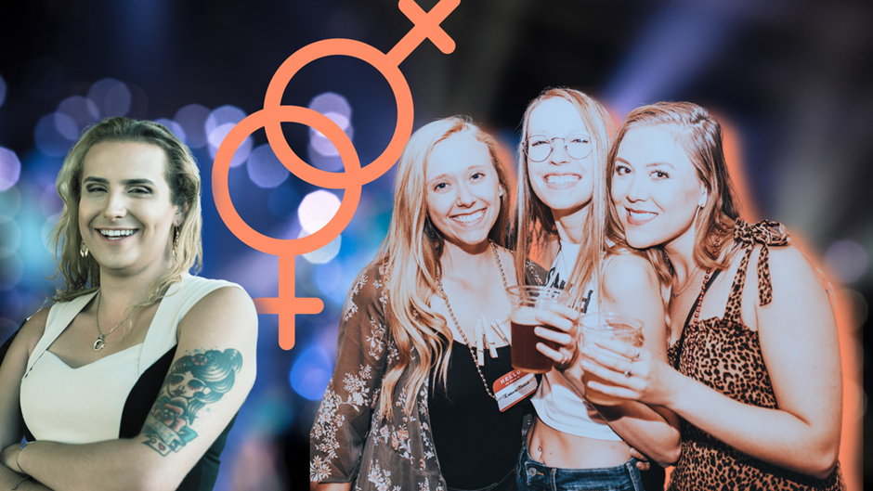
Lesbian spaces – going underground?
Exclusive: Lesbian Night Cancelled by London Pub for Going Female-Only
Shabby She loses regular booking at London pub after deciding to be women-only (March 2023)
Notes:
Going underground?
Story by Andreia Nobre, 1st March 2023, at: Exclusive: Lesbian Night Canceled by London Pub for Going Female-Only (4w.pub)
Shabby She has re-opened at another venue, and Kelly Frost says “We may have to go underground but we are not over and, even if we have to move the venue every single month, we will persist and thrive!”
Or Partying in Plain Sight?
A monthly music/dance night that used to be ‘For Lesbians, gay men and our friends’ - Described to me recently as “a lesbian highlight”
A recent event ‘For the LGBTQ+ community and our friends’ - Described to me as “the lesbian ball”

Slide 25
Lesbian spaces – doing it for ourselves?
“Sapphic Space is a female-only space. We correlate womanhood to the female biological sex as per its original definition, which naturally includes women of various expressions along the masculine and feminine polarity.
We assert that women should have the right to our own safe spaces, and we actively question the increasingly popularized gender and racial identity politics within the modern-day “queer” and “LGBT” community.
This space is exclusively open to women of color. “
Notes:
Are there lots of new lesbian groups, events, spaces springing up to fill gaps?
Is there unmet need for more – or different - lesbian spaces?
For whom? and where are the gaps?
Lots of anecdotes, personal stories, “I saw this online” “Someone told me …”
What do we know? What evidence have we got?

Slide 26
Recent research practice
Three recent surveys:
GEO LGBT survey 2018
DIVA survey 2021
NHS Digital LGB Health Survey 2021
And a USA one:
CDC (USA) NISVS 2010 survey; and ‘By SO’ report 2013
Notes:
Lesbian identity, community and current research practice:
Are lesbians being studied/ surveyed?
Where we’re included as part of broader social groups/ research populations, are we disaggregated?
Some good practice, some not
Government Equalities Office: National LGBT Survey: Research report - GOV.UK (www.gov.uk)
DIVA: INSIGHT SURVEY 2021 | Lesbian Visibility (lesbianvisibilityweek.com)
NHS: Health Survey England Additional Analyses - Health and health-related behaviours of Lesbian, Gay and Bisexual adults - NDRS (digital.nhs.uk)
CDC: Reports and Publications |Violence Prevention|Injury Center|CDC
Public Health England (2018)
Improving the health and wellbeing of lesbian and bisexual women and other women who have sex with women
Improving the health and wellbeing of lesbian and bisexual women (publishing.service.gov.uk)
“There is a significant gap in the evidence base for lesbian and bisexual women, and virtually no exploration of women who have sex with women. There is a clear opportunity for researchers, and research funders, to be more precise in the analysis of gender and sexual orientation and where possible to avoid combining LGB samples in reporting as this undervalues the needs of LBWSW.” (p.24, emphasis in original)

Slide 27
Improving research as an evidence base
Clarify ‘lesbian’ for research purposes
Ensure our participants include the lesbians we intend
Analyse and separate lesbian findings from others
Report who and what accurately
Address lack of specificity and focus in reporting research
Notes:
Target population and sample: appropriate to the research
Disaggregation in analysis and findings – clarity
Reports and publications – our own, and media/ others
Is the research investigating:
women who are same-sex attracted? or who are sexually active with other women?
Or who identify as lesbian? Or who are part of a lesbian community?
– appropriate to the research aims
E.g. health research may need to clarify sexual behaviour; attitudinal research may focus more on identity

Slide 28
My current research
Sex, Gender and Lesbians: Contemporary Debates in Contested Communities
Includes survey:
Lesbian Identity and Community (opens March 2023)
For more information:
lesbians.research@durham.ac.uk

Slide 29
Questions?

Slide 30
References: Lesbian Identity
Ainley, R. (1995) What is She Like? Lesbian Identities from the 1950s to the 1990s. London and New York: Cassell.
Megarry, J., Orian Weiss, C., Tyler, M. and Farhall, K. (2021) Women who prefer “lesbian” to “queer”: generational continuity and discontinuity. Journal of Lesbian Studies, DOI: 10.1080/10894160.2021.1950271
Obinwanne, A. (2018) Why I’m Lesbian (Not Queer). 26 April. Lesbian Nation LLC. Available at: https://afterellen.com/why-im-a-lesbian-not-queer/ Accessed: 26.10.2021.
Phelan, S. (1989) Identity Politics: Lesbian Feminism and the Limits of Community. Philadelphia: Temple University Press.
Reinfelder, M. (ed) (1996) From Amazon to Zami: Towards a Global Lesbian Feminism. London and New York: Cassell.
Traies, J. (2016) The Lives of Older Lesbians: Sexuality, Identity and the Life Course. London: Palgrave Macmillan.

Slide 31
References: Lesbian Community and Loss of Spaces
Forstie, C. (2020) Disappearing Dykes? Post-Lesbian Discourse and Shifting Identities and Communities. Journal of Homosexuality, 67:12, 1760-1778.
Nobre, A. (2023) Exclusive: Lesbian Night Cancelled by London Pub for Going Female-Only. 1st March. 4W - Feminist News. Available at: https://4w.pub/lesbian-night-canceled/ Accessed: 21.03.2023.
Podmore, J.A. (2006) Gone ‘underground’? Lesbian Visibility and the Consolidation of Queer Space in Montréal. Social & Cultural Geography, 7:4, 595-625.
Sex Matters (2023) Lesbians without Liberty: How the UK denies freedom of association to women who love women. Sex Matters: London.

Slide 32
References: Researching Lesbians
Brogan, Donna, Frank, E., Elon, L. and O’Hanlan, K.A. (2001) Methodologic Concerns in Defining Lesbian for Health Research. Epidemiology, 12:1, 109-113.
Eliason, M. J. (2016) Inside/out: Challenges of conducting research in lesbian communities. Journal of Lesbian Studies, 20(1), 136–156.
Fish, Julie. (1999) Sampling Lesbians: How to get 1000 Lesbians to Complete a Questionnaire. Feminism & Psychology, 9(2): 229–238.
Morris, J.F. and Rothblum, E.D. (1999) Who Fills Out a “Lesbian” Questionnaire? The Interrelationship of Sexual Orientation, Years “Out”, Disclosure of Sexual Orientation, Sexual Experience with Women, and Participation in the Lesbian Community. Psychology of Women Quarterly, Vol.23, 537-557.
Weston, Kath. (2009) The Lady Vanishes: On Never Knowing, Quite, Who is a Lesbian. Journal of Lesbian Studies, 13(2): 136–148.
Westwood, Sue. (2013) Researching Older Lesbians: Problems and Partial Solutions. Journal of Lesbian Studies, 17:3-4, 380-392.

